Slide 1
FEM modeling for elastic deformation
Traianos Karageorgiou
Sigurdur Ag. Sigurdsson
Sebastian Diaz
Lecturer: M. Karow

Slide 2

Overview
Introduction
$1D Beam$
$2D Prism$
$2D Beam$
Conclusion

Slide 3

Introduction
Used FEM to analyze the bending equation for the beam
w(x,t)
${\left(EIw^{′′}\right)}^{′′}x=q ⇒ Sw=q$
$μ\ddot{w}+\left(EIw^{′′}\right)′′=q ⇒ M\ddot{w}+Sw=q$
Dirichlet and Neumann boundary condition
Where E and I are
$E=\frac{2μ\left(3λ+2μ \right)}{2μ}$
$I=\int_{cross section}{z^{2}dydz}$
Time evolving the system
Solving the DAE
$\left[\begin{matrix}M & 0 \\ 0 & 0\end{matrix}\right]\ddot{w}+\left[\begin{matrix}S & C \\ C^{T} & 0\end{matrix}\right]w=\left[\begin{matrix}{\overline{τ}}_{Naumann}+\overline{f} \\ {\overline{u}}_{Dirichlet}\end{matrix}\right]$

Slide 4
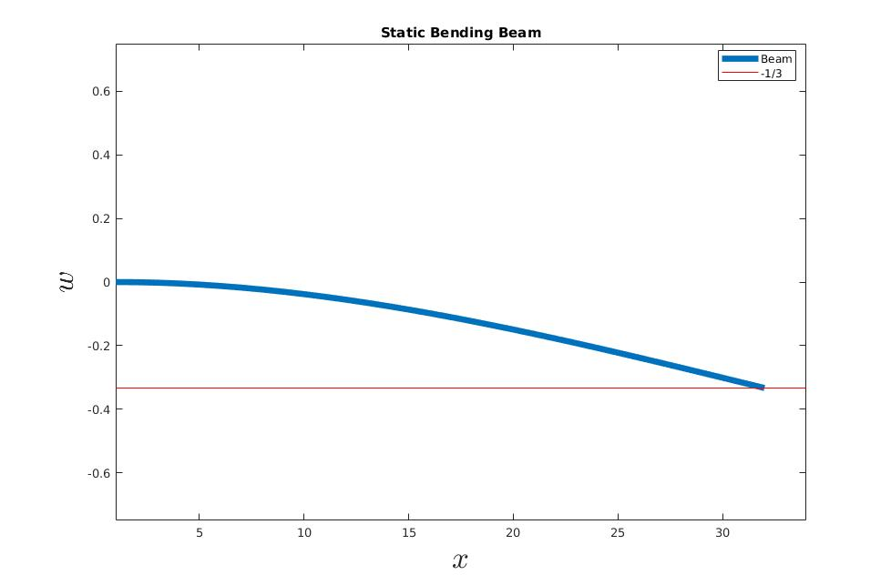

$$1D Static Beam$$
Static solution
Exact solution w(L)=-1/3

Slide 5


Newmark method
Time evolving the system
One step method
Developed for structural dynamics
Stable for $β∈\left[0,\frac{1}{2}\right] and γ∈\left[0,1\right]$
$$w_{j+1}=w_{j}+{\dot{w}}_{j}τ+\left(\left(\frac{1}{2}−β\right)\ddot{w_{j}}+β{\ddot{w}}_{j+1}\right)τ^{2}$$
${\dot{w}}_{j+1}=$ $\dot{w_{j}}+\left(\left(1−γ\right)\ddot{w_{j}}+γ{\ddot{w}}_{j+1}\right)τ$

Slide 6
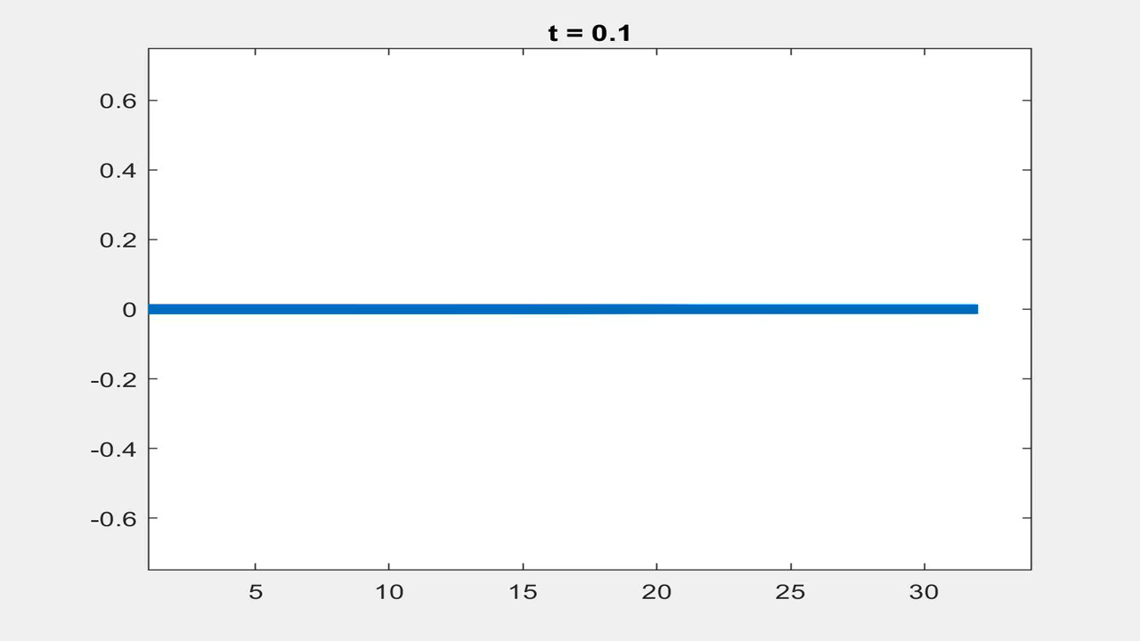


$$1D Loaded beam$$
$$w\left(t=0,x\right)=0$$
$$Q_{L}(t<5)=−1$$
$$Q_{L}\left(t>5\right)=0$$

Slide 7
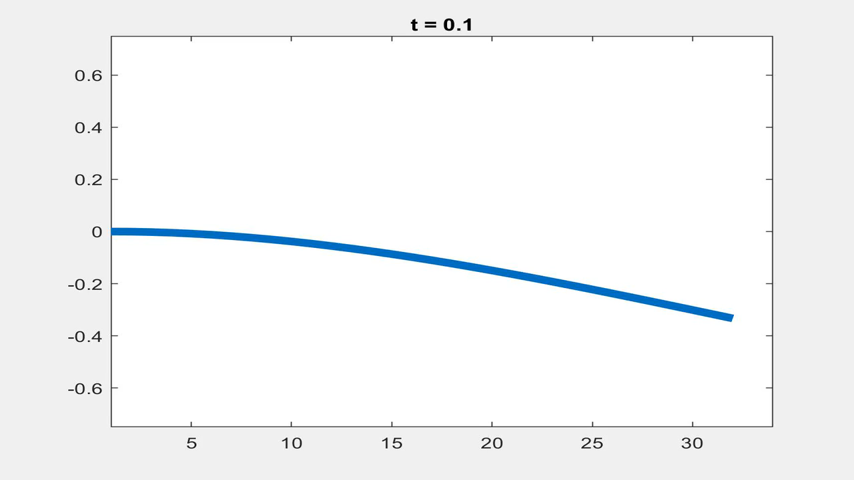


$$1D Starting Stationary beam$$
$$w\left(t=0,L\right)=−\frac{1}{3}$$
Stationary solution
$$Q_{L}(t<5)=−1$$
$$Q_{L}\left(t>5\right)=0$$

Slide 8

2D Prism
Single triangle under load
Aim: Derive a differential equation for the values $w_{k}(t)$ via the principle of virtual work.
Two points with a fixed $0$ displacement at the middle of two edges and a constant traction density $τ$ acts on the middle point of the third edge.

Slide 9
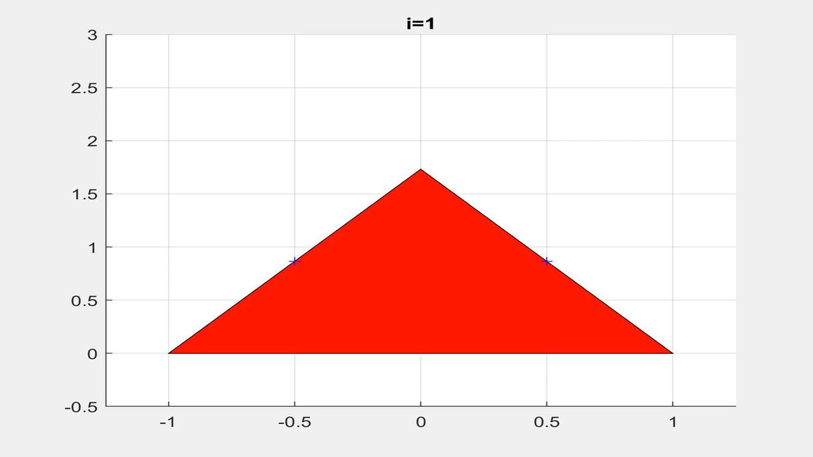

Pulling a Prism
$$τ\left(t=1\right)=−1$$
$$τ\left(t>1\right)=0$$

Slide 10
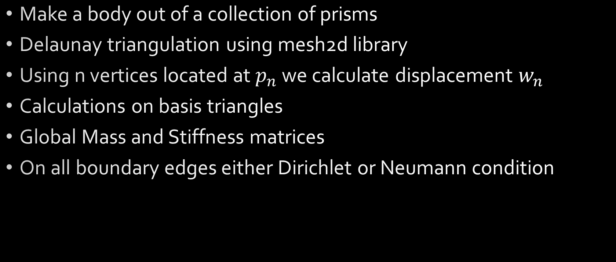
2D Multiple Prisms
Make a body out of a collection of prisms
Delaunay triangulation using mesh2d library
Using n vertices located at $p_{n}$ we calculate displacement $w_{n}$
Calculations on basis triangles
Global Mass and Stiffness matrices
On all boundary edges either Dirichlet or Neumann condition

Slide 11
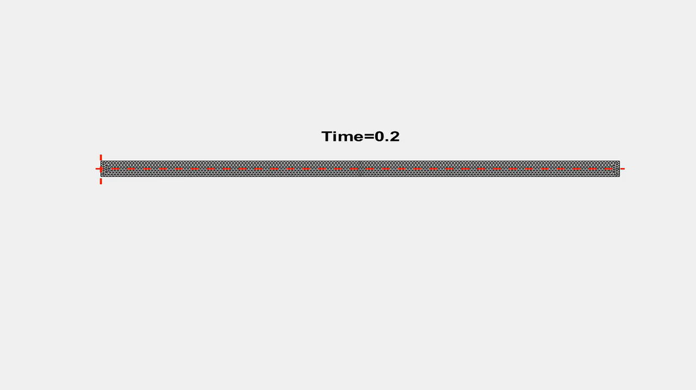
Triangles 2674

Slide 12
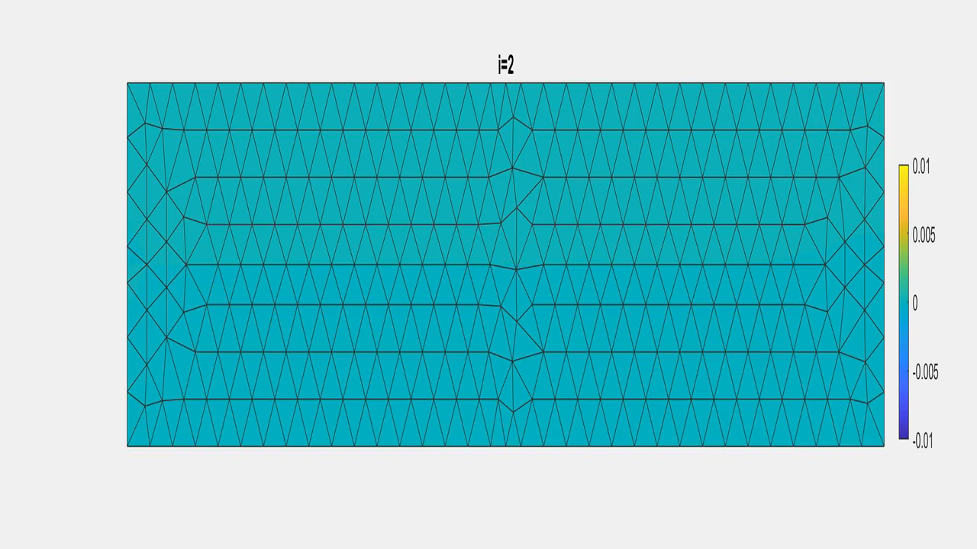

Slide 13
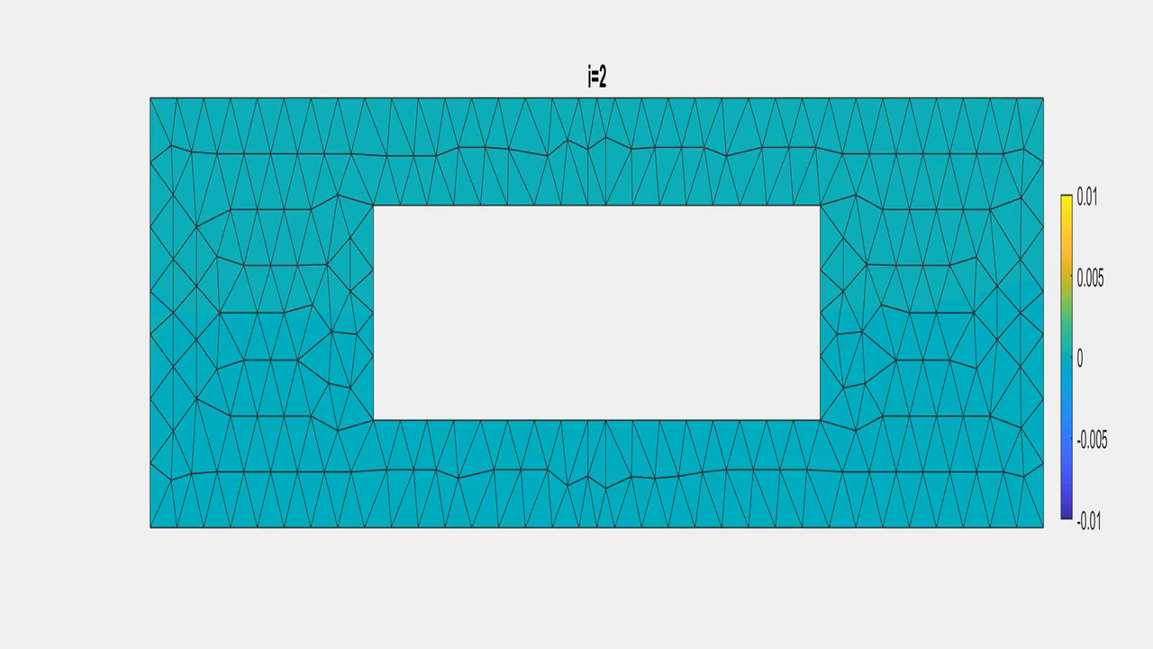

Slide 14
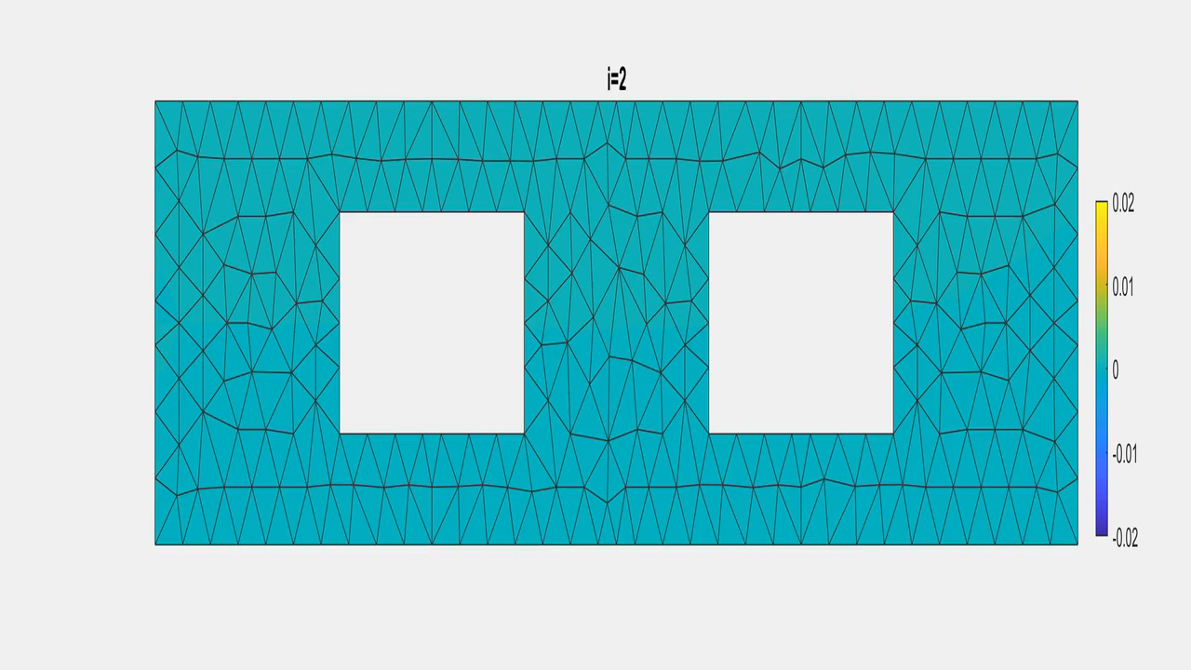

Slide 15
Conclusion
Without damping it will oscillate forever.
Starting from a stationary solution gives a steady state if the force stays applied.
The dimensions of the extended system depends on the amount of Dirichlet boundary conditions.
This code is suitable for applying different boundary force densities τ and initial displacements w into various positions and check the behavior of the beam.
Young modulus parameters λ,μ and density ρ affects the beam behavior

Slide 16

Thanks
https://github.com/traikaras/Project_in_num_analysis
Github logo : CC BY-SA

